Slide 1
Compiler Construction

Slide 2
Lexical Analysis
The Role of the Lexical Analyzer
Tokens, Patterns, and Lexemes
Attributes for Tokens
Lexical Errors

Slide 3
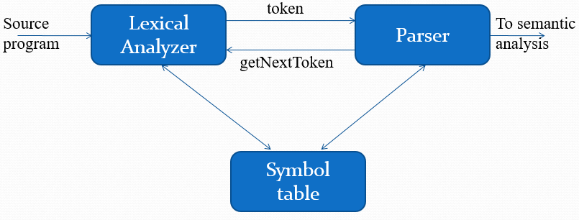
The role of the Lexical Analyzer
Lexical Analyzer reads the source program character by character to produce tokens.
Normally a lexical analyzer doesn’t return a list of tokens at one shot, it returns a token when the parser asks a token from it.
When the lexical analyzer discovers a lexeme constituting an identifier, it needs to enter that lexeme into the symbol table.

Slide 4
The role of Lexical the Analyzer (contd.)
Lexical Analyzer may perform certain other tasks besides identification of lexemes.
  Stripping out comments and white space.
  Error reporting
  Correlating error messages generated by the compiler with the source program.

Slide 5
Tokens, Patterns, and Lexemes
What are Major Terms for Lexical Analysis?
  TOKEN
    A token is a pair a token name and an optional token value
    Token represents a set of strings described by a pattern.
    Examples include <Identifier>, <number>, etc.
Notes:
Token is a classification for a common set of strings

Slide 6
Tokens, Patterns, and Lexemes (contd.)
What are Major Terms for Lexical Analysis?
  PATTERN
    The rules which characterize the set of strings for a token
    A pattern is a description of the form that the lexemes of a token may take
    Regular expressions are widely used to specify patterns.
    Finite Automata are widely used to recognize patterns.
Notes:
Token is a classification for a common set of strings

Slide 7
Tokens, Patterns, and Lexemes (contd.)
What are Major Terms for Lexical Analysis?
  LEXEME
    Lexemes are the smallest logical units of a program.
    A lexeme is a sequence of characters in the source program that matches the pattern for a token and is identified by the lexical analyzer as an instance of that token.
    Identifiers: position, initial, rate, x, count, etc…
Notes:
Token is a classification for a common set of strings

Slide 8
Example
Tokens, Patterns, and Lexemes (contd.)
Token
Informal description
Sample lexemes
if
Characters i, f
if
else
Characters e, l, s, e
else
comparison
< or > or <= or >= or == or !=
<=, !=
id
Letter followed by letter and digits
pi, score, D2
num
Any numeric constant
3.14159, 0, 6.02e23
literal
Anything but “ sorrounded by “
“core dumped”
printf(“total = %d\n”, score);

Slide 9
Tokens, Patterns, and Lexemes (contd.)
In many programming languages, the following classes cover most or all of the tokens:
  One token for each keyword.
  Tokens for the operators, either individually or in classes such as the token comparison mentioned in above table.
  One token representing all identifiers
  One or more tokens representing constants, such as numbers and literal strings
  Tokens for each punctuation symbol, such as left and right parenthesis, comma, and semicolon.
Notes:
Token is a classification for a common set of strings

Slide 10
Attributes for Tokens
Since a token can represent more than one lexeme, additional information should be held for that specific lexeme.
This additional information is called as the attribute of the token.
Token type and its attribute uniquely identifies a lexeme.
For simplicity, a token may have a single attribute which holds the required information for that token.
  For identifiers, this attribute a pointer to the symbol table, and the symbol table holds the actual attributes for that token.

Slide 11
Attributes for Tokens (contd.)
Example: E = M * C ** 2
  <id, pointer to symbol table entry for E>
  <assign-op>
  <id, pointer to symbol table entry for M>
  <mult-op>
  <id, pointer to symbol table entry for C>
  <exp-op>
  <number, integer value 2>
-no attribute is needed (if there is only one assignment operator)
Notes:
<num,val> where val is the actual value of the number.
lec01-lexicalanalyzer

Slide 12
Lexical Errors
Some errors are out of power of lexical analyzer to recognize:
  fi (a == 10) …
  whil ( x = 0 ) …
  generates no lexical errors

Slide 13
Lexical Errors (contd.)
However it may be able to recognize errors like:
  d = 2r
Such errors are recognized when no pattern for tokens matches a character sequence
In what Situations do Errors Occur?
  Lexical analyzer is unable to proceed because none of the patterns for tokens matches a prefix of remaining input.

Slide 14
Lexical Errors (contd.)
Panic mode Recovery
  Delete successive characters from the remaining input, until the analyzer can find a well-formed token at the beginning of what input is left.
Possible error recovery actions:
  Delete one character from the remaining input
  Insert a missing character into the remaining input
  Replace a character by another character
  Transpose two adjacent characters

